Slide 1

Vehicle Insurance System
A Web-Based Modernization of Automobile Insurance
Problem statement:
Imagine you are working for an insurance company that wants to modernize
its operations by developing a comprehensive Insurance Management
System for automobiles. The goal is to create a web-based application that
allows users to manage policies, claims, and customer information efficiently.
Presented by: Sourabh Vishwakarma

Slide 2

Project Objective:
To design and develop a secure, efficient, and user-friendly web-based
application that automates and streamlines theend-to-end process of
vehicle insurance management.
This includes enabling users to submit policy proposals, receive quotes, make premium
payments, download policy documents, and track their insurance status—while providing
insurance officers with tools to review, approve, and manage proposals, documents,
and policies—all within a secure, scalable, and responsive digital environment.
Develop a RESTful backend system to manage vehicle insurance operations
Implement modular, layered architecture using Java Spring Boot
Build a responsive frontend interface using Angular
Ensure secure user access with JWT-based authentication and role-based control
Use MySQL for efficient and scalable data storage
Provide interactive API documentation and testing via Swagger UI
Enable policy proposal, quote generation, premium payment, and policy tracking
Design system to support future enhancements like claim processing and cloud deployment
=

Slide 3
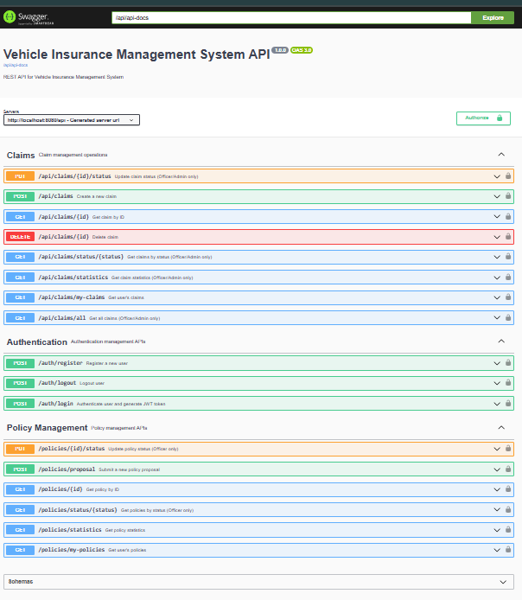
Technology Stack
Programming Language: Java 17
Backend Framework: Spring Boot
ORM: Spring Data JPA (Hibernate)
Database: MySQL
Build Tool: Maven
Authentication: JSON Web Token (JWT)
API Testing & Documentation: Swagger UI, Postman
Frontend Framework: Angular

Slide 4
Key Actors and Their Interactions
System Actors
User Use Cases
User: The policyholder or applicant.
Register & Login
Insurance Officer: Manages proposals and policies.
Submit Proposal
System: Handles authentication and automated notifications.
Make Premium Payment
Track Policy Status
Download Policy
Officer Use Cases
System Use Cases
Login
Secure JWT-based authentication
Review Proposals
Automated email notifications
Request Additional Info
Data validation and integrity checks
Approve/Reject Proposal
Generate Quote
Activate Policy

Slide 5
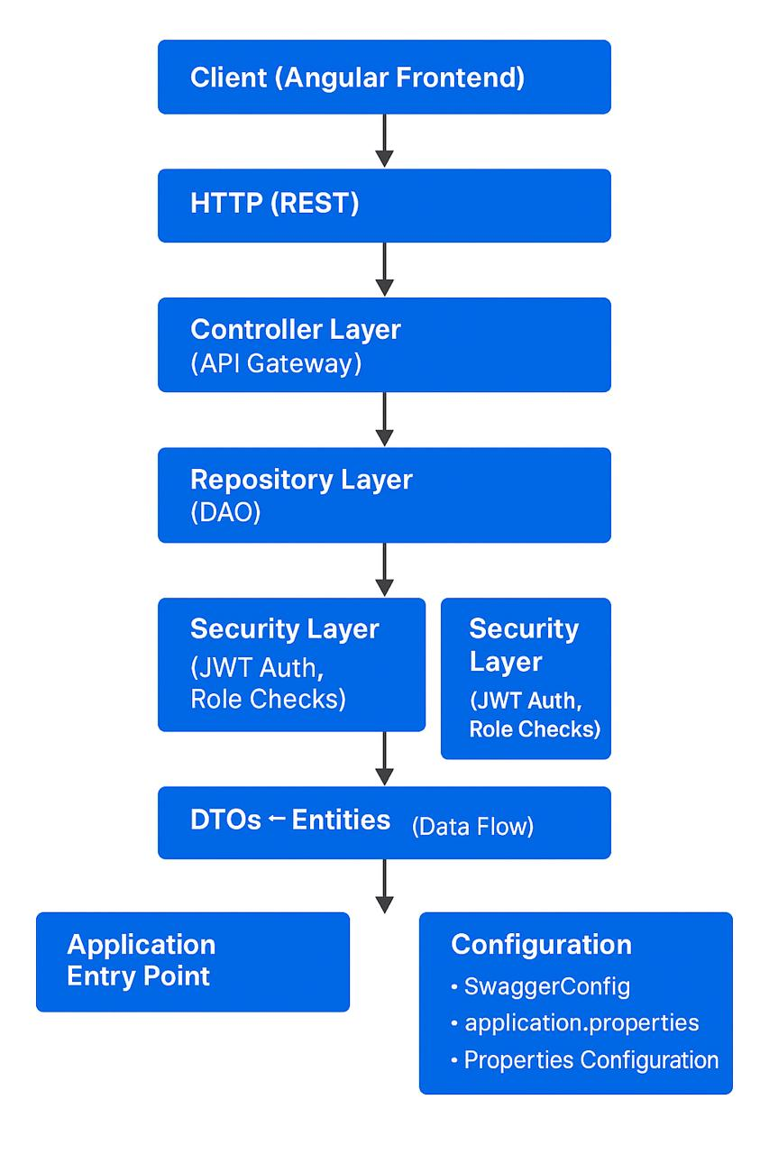
backend/
│
├── 📄 pom.xml # Maven configuration file
├── 📄 mvnw.cmd # Maven wrapper script (Windows)
│
├── 📁 .mvn/ # Maven wrapper configuration
│ └── wrapper/
│ └── maven-wrapper.properties
│
├── 📁 src/ # Source code directory
│ ├── 📁 main/ # Main application code
│ │ ├── 📁 java/ # Java source files
│ │ │ └── com/vehicleinsurance/ # Base package
│ │ │ │
│ │ │ ├── 📄 VehicleInsuranceApplication.java # Main Spring Boot class
│ │ │ │
│ │ │ ├── 📁 config/ # Configuration classes
│ │ │ │ └── SwaggerConfig.java
│ │ │ │
│ │ │ ├── 📁 controller/ # REST API controllers
│ │ │ │ ├── AuthController.java
│ │ │ │ ├── ClaimController.java
│ │ │ │ └── PolicyController.java
│ │ │ │
│ │ │ ├── 📁 dto/ # Data Transfer Objects
│ │ │ │ ├── ClaimDto.java
│ │ │ │ ├── LoginDto.java
│ │ │ │ ├── PolicyProposalDto.java
│ │ │ │ └── UserRegistrationDto.java
│ │ │ │
│ │ │ ├── 📁 entity/ # JPA Entity classes
│ │ │ │ ├── Claim.java
│ │ │ │ ├── ClaimStatus.java
│ │ │ │ ├── CoverageType.java
│ │ │ │ ├── Policy.java
│ │ │ │ ├── PolicyStatus.java
│ │ │ │ ├── Role.java
│ │ │ │ ├── User.java
│ │ │ │ └── VehicleType.java
│ │ │ │
│ │ │ ├── 📁 repository/ # JPA Repository interfaces
│ │ │ │ ├── ClaimRepository.java
│ │ │ │ ├── PolicyRepository.java
│ │ │ │ └── UserRepository.java
│ │ │ │
│ │ │ ├── 📁 security/ # Security configuration
│ │ │ │ ├── AuthEntryPointJwt.java
│ │ │ │ ├── AuthTokenFilter.java
│ │ │ │ ├── JwtUtils.java
│ │ │ │ ├── UserDetailsServiceImpl.java
│ │ │ │ └── WebSecurityConfig.java
│ │ │ │
│ │ │ └── 📁 service/ # Business logic services
│ │ │ ├── ClaimService.java
│ │ │ ├── PolicyService.java
│ │ │ ├── PremiumCalculationService.java
│ │ │ └── UserService.java
│ │ │
│ │ └── 📁 resources/ # Application resources
│ │ └── application.properties # Spring Boot configuration
│ │
│ └── 📁 test/ # Test source files
│ └── java/
│ └── com/vehicleinsurance/ # Test classes mirror structure
│
└── 📁 target/ # Build output directory (generated)
├── 📄 vehicle-insurance-backend-1.0.0.jar # Executable JAR file
├── 📁 classes/ # Compiled Java classes
├── 📁 generated-sources/ # Generated source files
├── 📁 maven-archiver/ # Maven build metadata
├── 📁 maven-status/ # Maven compilation status
└── 📁 test-classes/ # Compiled test classes
Backend
Folder
Structure
System
Architecture

Slide 6
Core Functional Modules
Authentication: Secure login for users and officers via JWT.
Document Handling: Upload and download PDF policy documents easily.
Proposal Management: Create, update, and track insurance proposals.
Policy Lifecycle: Track status changes and automate expiry reminders.
Quote Generation: Dynamic premium calculation based on vehicle details and add-ons.
Email Notifications: Automated alerts for quotes, payments, and policy expiry.

Slide 7
Authentication & Authorization (Planned)
✅ Open APIs currently enabled for demo and testing.
JWT-based login/signup structure implemented
👥 Role-Based Access Control (RBAC) planned with the following roles:
CUSTOMER – Can submit proposals, make payments, track policies
EMPLOYEE – Can review proposals, approve/reject, request documents
ADMIN – Full access to manage users, policies, and roles
🛡️ Access control hooks in place using Spring Security annotations (@PreAuthorize, @Secured)
🚀 Easily extendable to secure all endpoints when moved to production

Slide 8

Testing & Documentation
🧪 Unit & Integration Testing
Frameworks used: JUnit and Spring Boot Test
Focused on service and controller layers for business logic and API flow validation
📘 API Testing & Documentation
Swagger UI for live API documentation and testing
Postman used for manual testing and collection sharing
🧾 Structured JSON Error Responses
Custom global exception handling
User-readable messages with HTTP status codes

Slide 9
✅ Features Summary
✔️ RESTful APIs for seamless frontend-backend communication
✔️ Layered Architecture with clear separation of concerns
✔️ DTO-Based Design to ensure clean data exchange
✔️ Swagger UI Integration for interactive API documentation
✔️ Modular Codebase following best practices for scalability
✔️ Relational Database (MySQL) with proper entity relationships
✔️ Open for Testing, structured for future security upgrades (JWT, RBAC)

Slide 10
🚀 Future Enhancements
🔐 Enable JWT Login & Registration APIs Implement secure authentication and role-based access control
⚙️ Integrate CI/CD Pipeline using GitHub Actions Automate build, test, and deployment workflows
📦 Containerize with Docker Package backend and frontend for scalable deployment
🧑‍💼 Add Admin Dashboards & Frontend Integration Expand UI with role-specific views and functionalities
📊 Advanced Reporting Module with Charts Visualize key metrics like policy counts, claim ratios, and premium totals

Slide 11

Automobile Insurance System – Frontend Overview
Built with Angular Framework

Slide 12

Introduction to the Frontend
This presentation outlines the frontend architecture of our Automobile Insurance System, designed for seamless user interaction from policy inquiry to claim management. It acts as the visual and interactive gateway for all user activities.

Slide 13

Angular Frontend: The User's Gateway
Developed with Angular, our frontend provides a responsive and intuitive user experience. It's built upon a component-based architecture for scalability and maintainability.
Single Page Application (SPA)
Modular component design
Responsive across devices

Slide 14




Robust Technology Stack
Angular 15+
TypeScript
Modern framework for dynamic SPAs.
Enhanced code quality and maintainability.
HTML5 & SCSS
Component-Based
Semantic structure, efficient styling.
Modular and reusable UI elements.

Slide 15
Project Folder Structure
Key Directories
The frontend codebase is organized following Angular best practices, ensuring a clear separation of concerns and maintainability.
src/├── app/│ ├── components/│ ├── services/│ ├── modules/│ ├── assets/│ └── shared/├── environments/├── index.html└── main.ts
components: Reusable UI elements.
services: Business logic and data handling.
modules: Feature-specific groupings.
assets: Static files like images.

Slide 16
Core Frontend Components
Login & Register
Dashboard
Secure user authentication and new account creation.
Central hub for user options and summaries.
Proposal Form
Claims & Profile
Collects comprehensive insurance proposal data.
Manages claim submission and user detail editing.

Slide 17
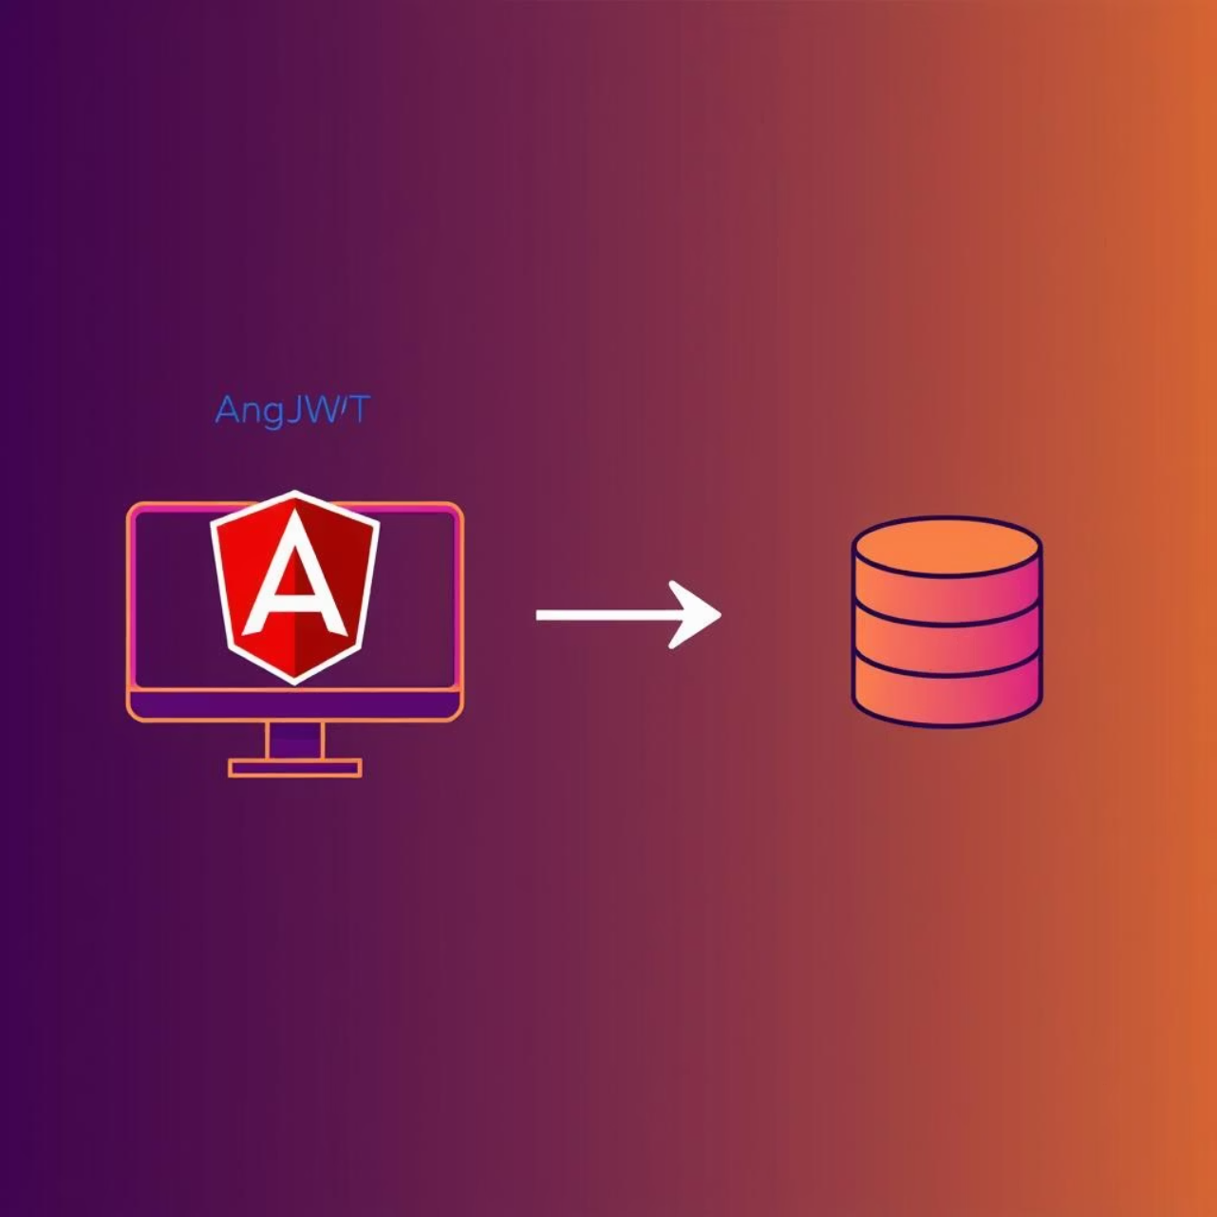
API Communication with HttpClient
Angular's HttpClient module is pivotal for seamless interaction with backend APIs. It handles all HTTP requests, ensuring secure and efficient data exchange.
Sends API requests for data retrieval and submission.
Integrates JWT (JSON Web Token) for secure authenticated sessions.
Tokens are stored in localStorage or sessionStorage for persistence.
Each request includes an Authorization header with the JWT for protected endpoints.

Slide 18




JWT-Based Authentication Flow
User Login
Token Issuance
Credentials sent to Auth API.
Auth API returns JWT on success.
Token Storage
Secure API Access
JWT stored locally (localStorage).
JWT included in headers for protected endpoints.

Slide 19





Key Frontend Features
Intuitive Onboarding
Policy Management
Simplified forms for quick user registration and policy quotation.
Users can view, modify, and renew policies directly through the portal.
Streamlined Claims
Real-time Support
Easy-to-use interface for submitting and tracking insurance claims.
Integrated chat and FAQ sections for immediate assistance.

Slide 20
Angular Forms and Validation
The system leverages Angular's Reactive Forms for robust and efficient data input. This ensures all user entries are validated in real-time, enhancing data integrity and user experience.
Reactive Forms: Provides a model-driven approach for handling form inputs.
Real-time Validation: Ensures data correctness for login, registration, and proposal forms.
Error Handling: Clear feedback to users on invalid inputs.

Slide 21




Seamless Backend Integration
The Angular frontend communicates with our Spring Boot REST APIs to process all data and business logic.
User Action
API Call
User interacts with frontend (e.g., clicks login, submits form).
Frontend sends request to specific Spring Boot REST endpoint.
Data Processing
Response Rendered
Backend processes request, interacts with database.
Frontend displays updated information to the user.

Slide 22
API Endpoint Examples
User Login
AuthController for authentication and JWT token generation.
New Proposal
ProposalController for creating and managing insurance quotes.
Policy Management
PolicyController handles policy updates and queries.
Claim Submission
ClaimController manages all claim-related operations.
Each interaction is mapped to a dedicated backend controller for organized and efficient data handling.

Slide 23



Future Enhancements
Dynamic Role-Based UI
Integrated Payment Gateway
Document Upload Functionality
Separate dashboards for policyholders, agents, and officers.
Secure and seamless premium payments via credit card, bank transfer.
Direct upload of vehicle RC, driving license, and other required documents.
Customized navigation and features based on user roles.
Automated payment reminders and recurring payment options.
Secure storage and easy retrieval of documents for users.
Enhanced security and data access control.
Automated document validation and status tracking.
Real-time payment status updates.

Slide 24

Conclusion: Empowering the User Experience
Seamless Interaction
Visual & Interactive Layer
The frontend ensures a smooth and efficient insurance workflow from start to finish.
Forms the crucial visual and interactive gateway of our comprehensive full-stack system.
Driving Future Growth
A robust foundation for continuous innovation and enhanced user satisfaction.

Slide 25
Thank you
Github- https://github.com/plasma84/AutomobileInsuranceSystem.git
vsourabh251@gmail.com

